Slide 1







2017
PowerShell Engine Internals
Build an immutable application infrastructure with Nano Server, PowerShell DSC, and the
release pipeline
Dongbo Wang
PowerShell Maintainer
dongbow@microsoft.com
Microsoft Corp.
Ravikanth Chaganti

Slide 2

2018
2017
Build an immutable application infrastructure with Nano Server, PowerShell DSC, and the
release pipeline
PowerShell Engine Internals
Ravikanth Chaganti
Dongbo Wang
Notes:
Good morning, my name is Dongbo Wang. I’m a developer in PowerShell team and also a maintainer of the PowerShell repository on Github.
I have been working on PowerShell for over 7 years, but this is my first time standing on a stage and give a talk about it, so, please bear with me.

Slide 3
Agenda
Overall architecture from E2E point of view
Walk through the execution workflow
Deep dive into involved components
Notes:
This talk is about the design and implementation of some key components of PowerShell engine.
We will look at each of those components by inspecting and walking through the execution process of a simple script.

Slide 4
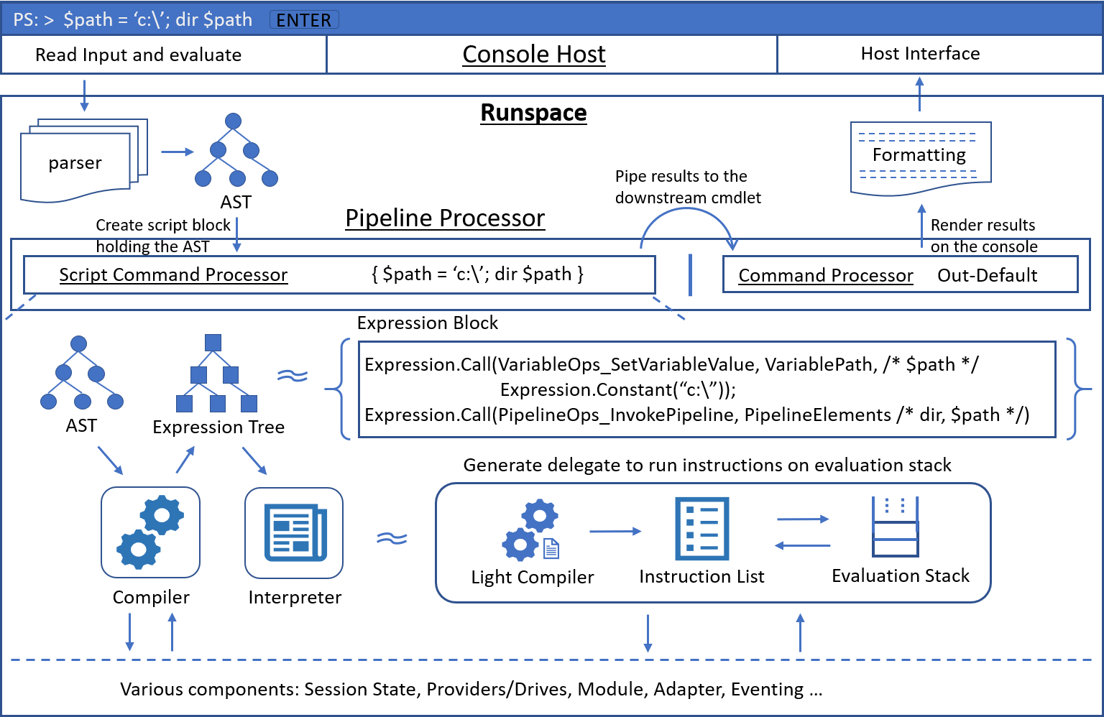
Architecture from an E2E view
// From Microsoft.PowerShell.ConsoleHost.dll
String input = ReadLineFromConsole(…)
Pipeline pipeline = CreatePipeline(…) : Commands[2]
[0] "$path = 'c:\'; dir $path"
[1] "Out-Default"
// Start a pipeline execution thread, which resolves commands to
// CommandProcessor’s and create a PipelineProcessor to execute
pipeline.Invoke()
Notes:
This diagram, is an overview of what happens when you are running a simple script from PowerShell console.
The script is trivial, we assign a string value to a variable $path, and then run ‘dir $path’.
[PressKey]
After you press ‘Enter’, this is what the console host does.
The host will read user input from the console,
then creates a pipeline object with 2 commands.
The first command is the input string, the second command is Out-Default.
Out-Default is a secrete cmdlet in PowerShell.
Whenever you run anything from the PowerShell console, out-default will be appended to the end of pipeline.
It takes input from the pipeline, including the results and possible error records produced from the user input script,
and then it renders them onto the console, in the pre-defined format,
so it works closely with the formatting system.
Finally, console host calls ‘Invoke()’ on the pipeline, to start a new thread.
We call the new thread “pipeline execution thread”,
which will resolve text commands into command processors and create a pipeline processor to run them all.
OK, question comes up – what is a command processor?

Slide 5
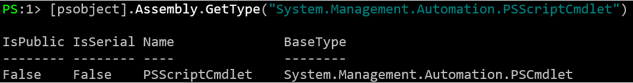
Command Processor
// Handle C# cmdlet and advanced scripts
class CommandProcessor : CommandProcessorBase
// Handle simple scripts
class ScriptCommandProcessor : CommandProcessorBase
// Handle native executables
class NativeCommandProcessor : CommandProcessorBase
[Cmdlet(verb, noun)
class ForEachObjectCommand : PSCmdlet
# Backed by ‘S.M.A.PSScriptCmdlet’ internally
function verb-noun {
[CmdletBinding()]
param()
}
# script body
function verb-noun {
param()
}
# script body
param(
$Param
)
# script body
param(
[Parameter()]
$Param
)
# script body
Ping.exe, git, ifconfig
Notes:
Command processor is where a command executes in PowerShell.
There are three command processors in PowerShell, each covers a different set of commands.
The first one, the type name is ”CommandProcessor”. Well, the name is a little too general,
[PressKey]
in fact, it only handles C# cmdlets and advanced functions.
Advanced functions are also known as ‘script cmdlets’.
They are essentially functions and scripts declared with the ‘CmdletBinding’ attribute or ‘Parameter’ attribute.
This set of commands have common parameter support from the runtime, like “Verbose”, “WarningAction” and etc.
and they have full access to all parameter binding features, like parameter sets, dynamic parameters, pipeline parameters and etc.
Well, you may wonder, one is in C# code, in IL binaries, and the other is script,
so how come these two are put in the same bucket?
It turns out internally advanced functions are represented by a special C# cmdlet type, named ‘PSScriptCmdlet’.
[PressKey]
As you can see from the screenshot, it’s an internal type, it derives from the type ‘PSCmdlet’, the same as any regular C# cmdlets.
The Begin, Process and End blocks are mapped to the BeginProcessing, ProcessRecord and EndProcessing methods correspondingly.
This is why advanced function is also called script cmdlet, because internally, they are cmdlets.
[PressKey]
The second one is “ScriptCommandProcessor”.
It handles simple scripts, which are essentially functions and scripts without the ‘CmdletBinding’ and ‘Parameter’ attributes.
This set of commands do not have common parameters,
and the restricted parameter binding rules are applied to them.
For example, you cannot use dynamic parameters with them.
[PressKey]
The last one is NativeCommandProcessor.
[PressKey]
It handles native executables.

Slide 6
Command Processor
void DoPrepare(IDictionary psDefaultParameterValues)
Setup context information
Do parameter binding
void DoBegin()
Called once before 'DoExecute'
void DoExecute()
Called 0 or N times
Driven by pipeline inputs
void DoComplete()
Called once after 'DoExecute'
Wrap up the execution
CommandProcessor
Run EndProcessing() on the cmdlet
ScriptCommandProcessor
Run End {..} block
NativeCommandProcessor
Wait for the executable process to exit
Do further cleanup
NativeCommandProcessor
Start the executable process
Redirect stdin/stdout/stderr as needed
CommandProcessor
Run BegineProcessing() on the cmdlet
ScriptCommandProcessor
Run Begin {..} block
CommandProcessor
Pipeline parameter binding
Run ProcessRecord() on the cmdlet
ScriptCommandProcessor
Bind pipeline input to '$_'
Run Process {..} block
NativeCommandProcessor
Feed pipeline input to stdin
Notes:
In order to execute a command, 4 key methods are implemented by every command processor.
They are DoPrepare, DoBegin, DoExecute and DoComplete.
They basically represent the lifecycle of a command execution.
DoPrepare runs only once before DoBegin.
It will set up context information and do parameter bindings.
[PressKey]
For NativeCommandProcessor, it will also start the executable process,
and redirect standard input, output and error streams as needed.
DoBegin runs only once before DoExecute, allowing the command to initialize itself.
[PressKey]
For the CommandProcessor type, it runs the BeginProcessing method of the cmdlet.
For the ScriptCommandProcessor, it runs the Begin block
The native command processor has been already setup in the DoPrepare method, so it does nothing here.
[PressKey]
DoExecute runs 0 or multiple times, depending on its position in the pipeline and whether there is input from the pipeline.
If it’s the first command in the pipeline, then DoExecute will be called at least once.
If it’s in the middle of a pipeline, then it’s totally driven by the pipeline input.
If there is no input from pipeline, DoExecute may never be called.
[PressKey]
For the CommandProcessor, it will read the input, bind pipeline parameters,
and then run the ProcessRecord method of the cmdlet.
For the ScriptCommandProcessor, it will read the input, bind it to $_, and then run the Process block.
For the NativeCommandProcessor, it will feed the pipeline input to the redirected input stream of the executable process.
[PressKey]
DoComplete runs only once after DoExecute, allowing the command to wrap up its execution.
For the CommandProcessor, it will call the EndProcessing method of the cmdlet
For the ScriptCommandProcessor, it will call the End block.
For the NativeCommandProcessor, it will wait for the process to exit and do some cleanup work.
Now we have the basic ideas about the command processor, what they are, what they do,
It’s time to see how a command gets resolved to a command processor.

Slide 7
Command Resolution
// From the ConsoleHost thread
Pipeline pipeline = CreatePipeline(…) : Commands[2]
[0] "$path = 'c:\'; dir $path" // user input string
[1] "Out-Default" // command name
// From the pipeline execution thread
Command[0] => ScriptCommandProcessor
Command[1] => CommandProcessor
Notes:
Back in the console host, the commands in the pipeline object are in the form of text,
It’s either a string of the script read from the console, or a command name
In the pipeline execution thread, those strings need to be resolved to the corresponding command processors.
[PressKey]
For a string of script, parser will kick in and parse the text into an abstract syntax tree, which will be used to create a script block.
And then, a script command processor is constructed with the script block.
[PressKey]
For a command name, things are relatively complex. The command discovery component will kick in to resolve the command.

Slide 8
Command Discovery
Run pre-lookup action before lookup starts
Walk up the scope chain to search
Alias, function, cmdlet, .ps1, application
Look up native executables in PWD and PATH
Module auto-discovery and auto-loading
Run post-lookup action if command is found
Run command-not-found action otherwise
/src/System.Management.Automation/engine/CommandDiscovery.cs
// Pseudo code
switch (commandInfo.CommandType) {
case CommandTypes.Application:
return new NativeCommandProcessor(…);
case CommandTypes.Cmdlet:
return new CommandProcessor(…);
case CommandTypes.Function when UsesCmdletBinding:
case CommandTypes.Script when UsesCmdletBinding:
return new CommandProcessor(…);
case CommandTypes.Filter:
case CommandTypes.Function:
case CommandTypes.Script:
return new ScriptCommandProcessor(…);
}
# System.EventHandler<CommandLookupEventArgs> $ExecutionContext.InvokeCommand.PreCommandLookupAction
You can stop the search and set a result command in the action:
CommandLookupEventArgs.StopSearch [bool]
CommandLookupEventArgs.Command [CommandInfo]
Dynamic scoping
Starting from ‘EngineSessionState.CurrentScope’
Walk up until reaching global scope
Search modules in $env:PSModulePath
Analyze modules – exported commands
‘.psd1’ metadata, ‘.psm1’ AST analysis – lightweight analysis
‘Import-Module -ListAvailable’ – heavyweight analysis
Serialize analysis cache to file to share across process
Hold the serialization until cache is relative stable
Serialize to file asynchronously via Task
Read/write the file in a best-effort way to avoid mutex
# System.EventHandler<CommandLookupEventArgs> $ExecutionContext.InvokeCommand.PostCommandLookupAction
CommandLookupEventArgs.Command [CommandInfo]
# System.EventHandler<CommandLookupEventArgs> $ExecutionContext.InvokeCommand.CommandNotFoundAction
CommandLookupEventArgs.Command [CommandInfo]
Notes:
Command discovery is the component where PowerShell searches for a command based on the given name.
The search algorithm looks roughtly like this.
[PressKey]
First, the pre-lookup event handle will be triggered, if it’s set.
In the handler, you can decide which command to return as the result, and tell the search to stop.
[PressKey]
If the search is not stopped, then, PowerShell will look up the command through the scope chain.
PowerShell is dynamic scoping, functions, aliases, cmdelts, and variables are all stored in scopes.
In this step, the search will start from the immediate scope, then the parent scope and so on, until reaching the global scope.
The preference order of command types during search is alias, function, cmdlet, .ps1 files, and application.
[PressKey]
If the command is not found after this step,
module discovery will be triggered to look for the command from modules available in the module path.
This involves module analysis to get the exported commands from available modules.
PowerShell tries the lightweight analysis first,
basically reading metadata from module manifest to find exported module members,
or parsing script modules and analyze the AST to find exported members.
If it has to, PowerShell will fall back to the heavy weight analysis, by calling ‘Import-Module -ListAvailable’,
which essentially goes through all the processing of importing a module without actually loading its elements.
The lightweight analysis usually is sufficient in the most of the common scenarios.
The module analysis produces a table of commands exported from modules.
This result is cached in the PowerShell process, so the same modules don’t need to be analyzed again in a later command discovery search.
Furthermore, PowerShell attempts to serialize the cache to a file, so that other PowerShell process can benefit from it.
PowerShell tries to make this serialization/de-serialization as simple and efficient as possible.
A serialization request is triggered when there is any update to the cache.
However, the writing operation is held until the cache becomes relatively stable, which means when there are less frequent changes to the cache.
Writing to the file happens in a Task, in a completely asynchronous way.
Instead of using Mutext to guard the file read/write access, PowerShell read/write the file only depending on the file lock.
If it’s able to open the file, great, read the cached results and benefit from them, or write the updated cache to the file to share with other processes.
If it’s not able to open the file, say it’s being used by another PowerShell process,
then for the reading operation, it will try 2 more times with a 25ms interval, because we really want to skip the module analysis if it’s possible.
But, it will give up after 2 more tries, and turn to module analysis.
For the writing operation, it will just skip this write, because an update to the cache can always trigger another serialization request.
After the whole process of module-discovery, we get back a table of commands exported from available modules.
If we find the target command in the table, awesome, we auto-load the module and return the result.
If not, then we give up.
[PressKey]
If the command is found, a post-lookup event handler will be triggered, if it’s set.
The found command will be passed to the handler,
and you can change the result in the handler by setting the ‘Command’ property on the event arg.
[PressKey]
If the command is not found, a command-not-found event handler will be triggered, if it’s set.
Again, you can decide which command to return as the result in this handler.
[PressKey]
If the command discovery search is successful, we will get back a CommandInfo object representing the command.
Based on the command type of the CommandInfo object, the appropriate command processor will be created with the CommandInfo object.

Slide 9
Architecture from an E2E view
outputPipe.AddToPipe(outputResult);
void AddToPipe(object obj) {
ObjectQueue.Enqueue(obj);
if (DownstreamCmdlet != null && ObjectQueue.Count > OutBufferCount) {
DownstreamCmdlet.DoExecute();
}
}
class Pipe {
internal CommandProcessorBase DownstreamCmdlet; …
}
OutputPipe.DownstreamCmdlet = CommandProcessor{out-default}
Notes:
OK, now that both commands have been resolved, a pipeline processor will be created to chain them together with pipes and start the execution.
Pipes are where a command processor writes out streams to, such as the output stream, error stream, warning and etc.
When adding a command processor to the pipeline processor, the command processor will be set as the downstream command in the previous command processor’s output pipe.
[PressKey]
So in our example here, the Out-Default will be set as the downstream command in the script command processor’s output pipe.
[PressKey]
When the script runs and produces any results, the result objects will be added to its output pipe,
which will trigger a call to the ‘DoExecute()’ method on the downstream command processor.
The ‘DoExecute’ method will then read the object from the pipe, do pipeline parameter binding,
and eventually call ‘ProcessRecord’ of the out-default command.
This is how two or multiple commands are chained in the pipeline;
This is how the output of one command flows to the next and triggers its execution;
And this is also why we say the ‘DoExecute’ method is driven by the pipeline input,
because if nothing is written to the pipe, then this method will never be invoked for a downstream command.
Now, let’s back up a little bit, and see how a pipeline processor starts an execution.

Slide 10
PipelineProcessor
SynchronousExecuteEnumerate (object input)
Call “DoPrepare” on every command processor
Call “DoBegin” on every command processor
Call “DoExecute” on the first command processor
Call “DoComplete” on every command processor
“DoExecute” may run “DoBegin”, if it hasn’t run yet
/src/System.Management.Automation/engine/pipeline.cs
Notes:
The method “SynchronousExecuteEnumerate” starts the execution of the pipeline processor.
It first calls “DoPrepare” on every command processor in this pipeline, to have them setting up context information, binding parameters.
Then it calls “DoBegin” on every command processor, to allow them to initialize.
Next, it calls “DoExecute” on the first command processor.
If it produces any output, great, that will drive the “DoExecute” method from downstream commands to run.
If it doesn’t produce anything, it’s fine, it just means that the “DoExecute” methods from downstream commands might not be invoked.
At last, it calls “DoComplete” on every command processor, to wrap up the execution.
Be noted that output may be produced from “DoBegin” when running a begin block in script, or a BeginProcessing method.
The output will be also written to the output pipe,
which will trigger the “DoExecute” method of the downstream command.
However, by that time, the “Begin” block or the “BeginProcessing” method of the downstream command hasn’t been run yet .
which means it hasn’t been initialized.
The solution to that problem is to call “DoBegin” in “DoExecute”, if the “DoBegin” method hasn’t run yet.
Similarly, output may be produced from “DoComplete”,
which will also trigger the “DoExecute” method of the downstream command,
but by that time, “DoBegin” has already run for all command processors, so it’s OK.

Slide 11
Compiler: Code Generation
$file.Name =>
var target = Expression.Call(VariableOps_GetVaraibleValue, “file”);
var binder = PSGetMemberBinder.Get(memberName: “Name”, isInstance: true);
return DynamicExpression.Dynamic(binder, target);
PSGetMemberBinder.FallbackGetMember(target) =>
Expression.Property(targetExpression, PropertyInfo{Name})
// Dynamic Language Runtime
DynamicExpression.Dynamic(PSBinaryOperationBinder.Get(et), …)
DynamicExpression.Dynamic(PSEnumerableBinder.Get(), …)
DynamicExpression.Dynamic(PSUnaryOperationBinder.Get(ExpressionType.Not), …)
DynamicExpression.Dynamic(PSGetMemberBinder.Get(…), …)
DynamicExpression.Dynamic(PSGetDynamicMemberBinder.Get(…), …)
… …
Notes:
The script we are about to run only has the End block, so its execution starts when “DoComplete” is called on the script command processor.
[PressKey]
Now let’s explore how a script gets to run behind the scene.
In order to execute a script block, it needs to be compiled first.
Given an abstract syntax tree, the PowerShell compiler will visit every node and generate code for it.
The generated code is represented in a LINQ expression tree.
[PressKey]
For our simple script here, the generated expression block would be something like this.
[PressKey]
The compiler leverages the DLR heavily in the code. It uses “DynamicExpressions + CallSiteBinders” to handle most of the dynamic binding operations like member access, method invocation, indexing, binary operations and etc.
Every CallSiteBinder has a “FallBack*” method, and that’s where dynamic binding happens.
[PressKey]
Take the PSGetMemberBinder as an instance. It has a method named “FallbackGetMember”, which is responsible for generating the real code for a property access operation like “$file.Name”.
Let’s look at $file.Name. For such a MemberExpressionAst, compiler will generate code roughly like this.
Get the value of $file,
get a static binder instance based on the member name and whether it’s an instance member.
then return a dynamic expression with the binder and target.
It’s worth mentioning here that a binder for a particular operation is static and shared across the PowerShell process.
So if we need to do the same binding operation, the same binder will be used.
When the dynamic expression gets to run, it will ask the binder, “hey, what am I supposed to do?”
The binder then will call its FallbackGetMember method with the value of $file,
do the late binding, then return an expression and say “here is the real code, go run it”.
So you can see that the CallSiteBinder provides us a clean way to organize the dynamic binding code.
And furthermore, it also makes the late binding much faster thanks to its binding result caching.
A binder is able to cache 128 binding results.
When a “FallBack*” method produces an expression, it also produces the restriction for using that expression, usually based on the types of the arguments passed to the “FallBack*” method.
The restriction and expression will then be inserted in the binder’s cache like a key value pair.
Say later, there comes another member expression $anotherFile.Name and we assume the value of $anotherFile is of the same type as $file,
Then the ‘PSGetMemberBinder’ will not call its “FallBackGetMember” method again. Instead, the binder will find a match in its cache, and return the corresponding expression immediately.
This avoids duplicate binding resolutions for operations of the same category, and therefore it makes the script run much faster.
[PressKey]
Now we have an expression tree representing the operations in the End block of this script,
but expression tree is still data, it’s code-as-data. So how do we run it?

Slide 12
Compiler: Expression to Delegate
// Action to perform
Expression Block {
…
}
// Runtime context
FunctionContext {
…
}
Expression<Action<FunctionContext>>
Notes:
The answer is: turn the expression tree into a delegate of executable code.
[PressKey]
Let’s see what we have on hand, an Expression Tree representing the actions to perform, and the runtime environment to perform the actions on.
The runtime environment is represented by the “FunctionContext” type, including things like
the script block that is being compiled,
the ExecutionContext that refers to other components in the Runspace,
the pipes where streams are going to be written to, and so on and so forth.
So it’s natural that we can combine these two into a lambda expression,
which represents a set of operations based on a context parameter.
Now, finally, we have a lambda expression that represent a delegate for the End block of the script.
But, it’s still an expression, a data, so again, how do we run it?

Slide 13
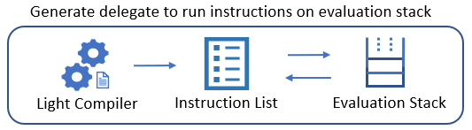
Compiler: Expression to Delegate (cont.)
Compile Lambda expression into IL
Expression<Action<FunctionContext>>.Compile()
Pros: Generate very fast executable code
Cons: Compilation to IL is very expensive
Run with an interpreter
Expression tree to instructions
Return an delegate that points to an instance method
Create the evaluation stack
Run the instructions
// NewArrayBoundsInstruction
public override int Run(InterpretedFrame frame)
{
var lengths = new int[_rank];
for (int i = _rank - 1; i >= 0; i--)
{
lengths[i] = (int)frame.Pop();
}
var array = Array.CreateInstance(_elementType, lengths);
frame.Push(array);
return 1;
}
System/Linq/Expressions/Interpreter/:
http://source.dot.net/#System.Linq.Expressions/System/Linq/Expressions/Interpreter/LightCompiler.cs,c54887f1bd1d5a56
System.Management.Automation/engine/interpreter:
https://github.com/PowerShell/PowerShell/blob/master/src/System.Management.Automation/engine/interpreter/LightCompiler.cs
Notes:
Of course, we need to generate a real delegate with executable code from the expression.
There are two approaches to do it.
The first one, compile the lambda expression directly into IL by calling the ”Compile” method on the lambda expression.
This will produce a delegate pointing to the IL code.
This approach can generate very efficient executable code, but on the other hand, the compilation to IL is very expensive.
which means it’s very expensive to generate the delegate in the first place.
The second one, run with an interpreter.
[PressKey]
PowerShell uses the same interpreter that is used by LINQ Expression in .NET.
The code was copied to PowerShell in version 3 with some PowerShell specific changes.
[PressKey]
Given a lambda expression, the interpreter visits every expression node in its body and emit instructions.
Every instruction has a Run method, which contains the c# code that will execute when the instruction runs.
Instructions work in a way as if they are on a single-stack evaluator.
The Run method may read, remove or add data to or from the stack, call methods, and copy variables to or from the stack.
[PressKey]
Here is an example. This is the Run method from the “NewArray” instruction.
[PressKey]
After all instructions are generated, the interpreter will create a delegate,
which essentially points to an instance method of the interpreter.
That method will create a stack and execute the instructions one by one when it’s invoked.
This approach generates less efficient executable code, but on the other hand, it’s less expensive to generate the delegate.
PowerShell takes advantage of both approaches.
By default, PowerShell runs the lambda expression with the interpreter.
This is because it’s too expensive to always compile the lambda expression to IL.
However, we do want more efficient executable code for hot script that runs many times.
So PowerShell introduces a threshold, if the script is not too large (it has less than 300 statements)
and the interpreter-based delegate runs more than 32 times,
then the lambda expression will be compiled into IL and the IL delegate will be used for subsequent executions.

Slide 14
Finish Pipeline Execution
End { … } => Action<FunctionContext> EndBlock
// Keep the delegate in the script block
_scriptBlock.EndBlock = EndBlock
outputPipe.Add([FileInfo][1])
outputPipe.Add([FileInfo][2])
outputPipe.Add([DirectoryInfo][3])
…
Notes:
By now, a delegate with executable code has been generated for the End block of the script.
The delegate will be invoked to perform the operations defined in the script.
The delegate will also be kept in the current script block,
so the next time you invoke the same script block, PowerShell can directly use the delegate without having to compile it again.
[PressKey]
Of course, the execution of our script will generate output – files and directories,
which will be written to the output pipe and drive the downstream command to execute.
[PressKey]
Then the “ProcessRecord” method of Out-Default will run, to render the output onto the console, based on the pre-defined formatting.
OK, we are done, that is what happens when you run this script from PowerShell console.

Slide 15
Summary
Inspected the execution of a script from PS console
Talked about some key components involved
Command Processor
Command Discovery
Pipeline Processor
Compiler
Interpreter

Slide 16
Next Steps
Now: 15 min break
Grab a coffee
Stay here to enjoy next presentation
Change track and switch to another room
Ask me questions or meet me in a breakout session room afterwards

Slide 17
Questions?

